Slide 1
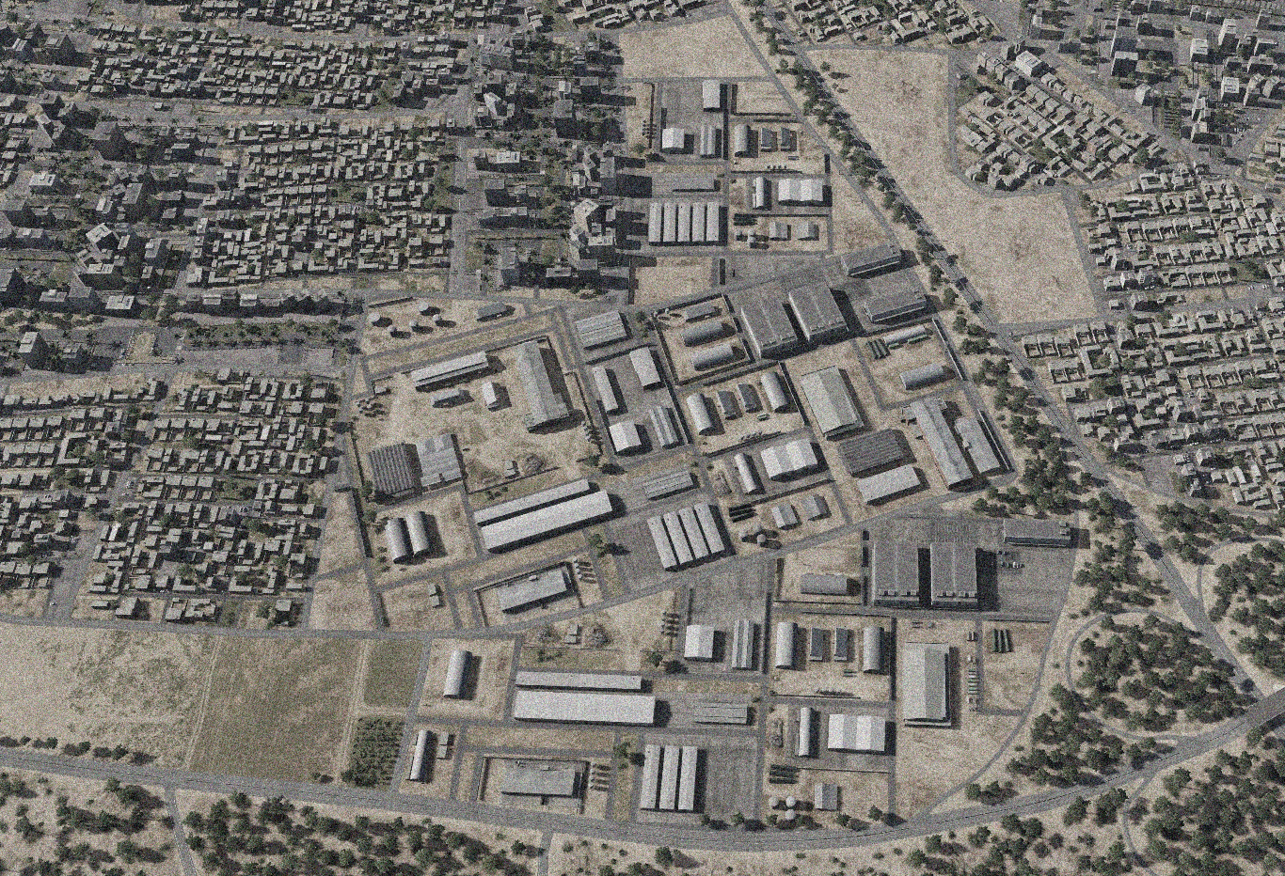

OPARTGT015 MEZZEH AMMUNITION FACTORY
N
10
9
11
5
7
8
4
6
14
3
12
13
14
DESIRED POINT of IMPACT:
DPI 14 - N33 29.621 E 36 19.281 / 2205ft / 2000lb PGM
DPI 13 - N33 29.648 E 36 19.313 / 2197ft / 2000lb PGM
DPI 11 - N33 29.737 E 36 19.271 / 2203ft / 2000lb PGM
DPI 10 - N33 29.771 E 36 19.271 / 2207ft / 2000lb PGM
DPI 9 - N33 29.732 E 36 19.240 / 2215ft / 2000lb PGM
DPI 8 - N33 29.729 E 36 19.227 / 2215ft / 2000lb PGM
DPI 7 - N33 29.722 E 36 19.206 / 2212ft / 2000lb PGM
DPI 6 - N33 29.720 E 36 19.194 / 2210ft / 2000lb PGM
DPI 5 - N33 29.719 E 36 19.157 / 2205ft / 2000lb PGM
DPI 4 - N33 29.701 E 36 19.165 / 2204ft / 2000lb PGM
DPI 3 - N33 29.681 E 36 19.048 / 2193ft / 2000lb PGM
DPI 2 - N33 29.598 E 36 19.070 / 2199ft / 2000lb PGM
DPI 1 - N33 29.560 E 36 19.069 / 2198ft / 2000lb PGM
2
1
CDC - High density civilian housing 90m from facility. Numerous buildings of religious significance within 500m of facility.

